Slide 1
Univariate Distribution and
Probability Density Distribution (PDD) Histograms
Sunday, 10/22/2017
12-Month Ocean Carbon States (OCS) Dataset

Slide 2
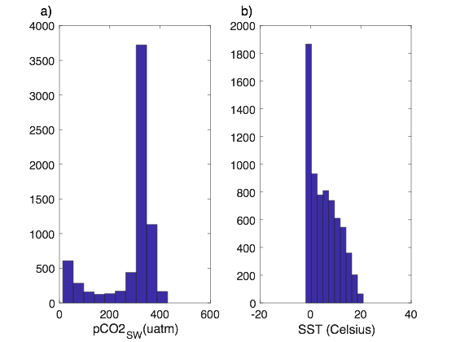
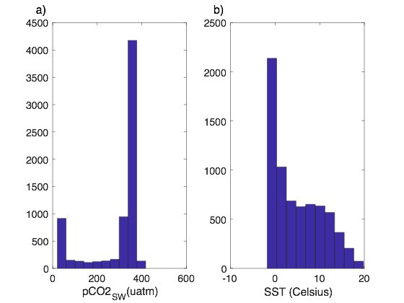
Southern Ocean - Reproduced from OCS Toolbox
Sunday, 10/22/2017
Model
Observations
Notes:
pCO2 and SST were selected as they were naturally used for understanding air-sea flux of CO2 data.

Slide 3
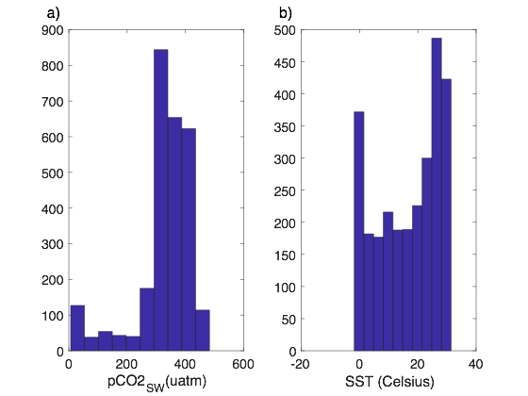
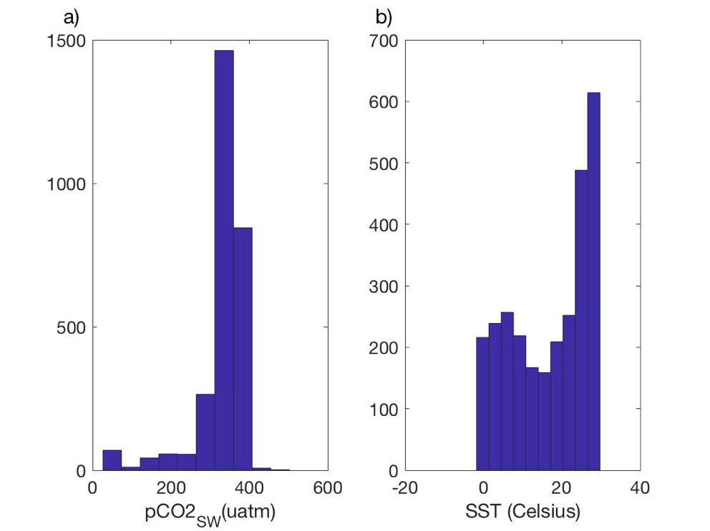
North Atlantic - Reproduced from OCS Toolbox
Sunday, 10/22/2017
Model
Observations

Slide 4
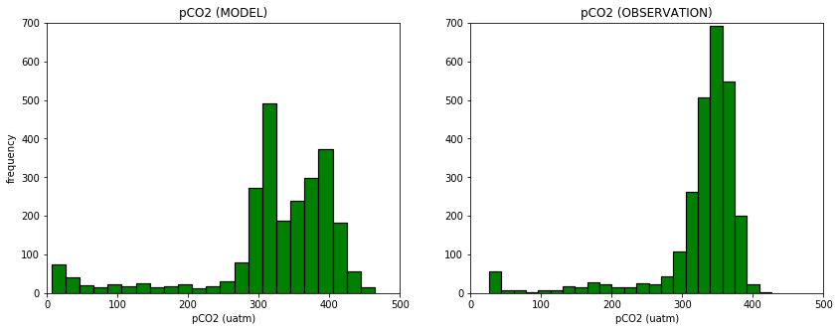
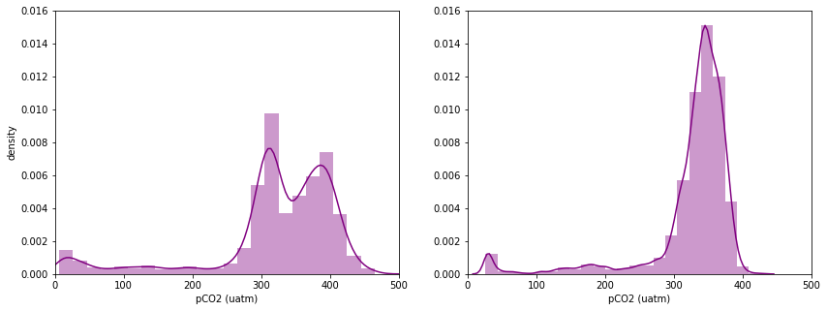
Mod v. Obs: pCO2 (surface water)
Sunday, 11/12/2017

Slide 5
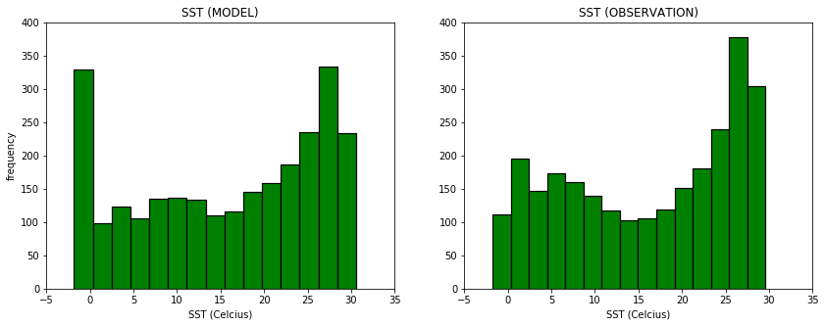
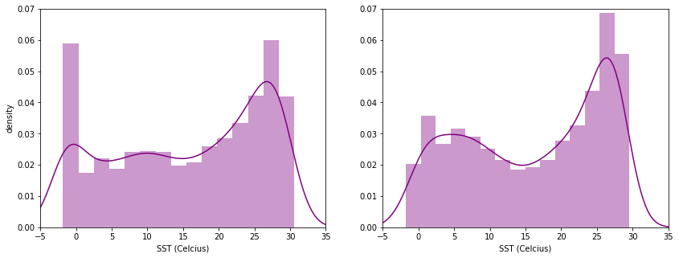
Mod v. Obs: Sea Surface Temperature (SST)
Sunday, 11/12/2017

Slide 6
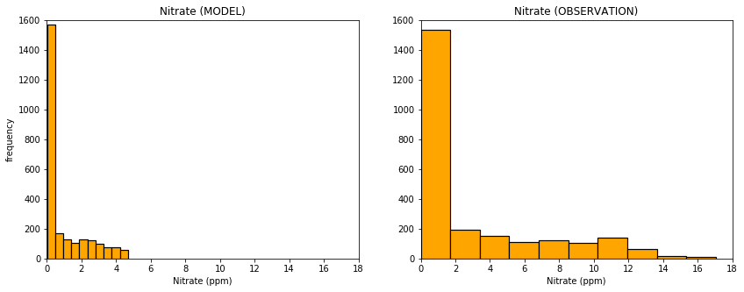
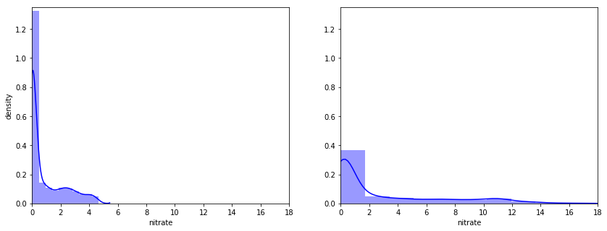
Mod v. Obs: Nitrate (NITR)
Sunday, 11/12/2017
Notes:
source:
http://www.uky.edu/KGS/pubs/ic60_11whatsit.htm

Slide 7
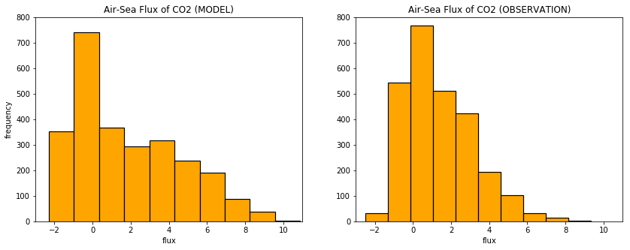
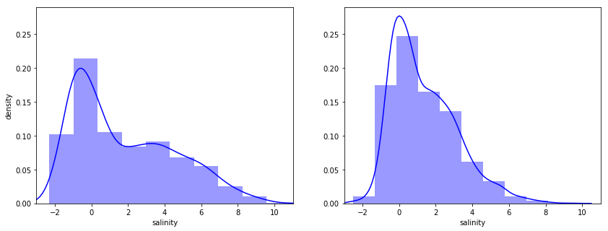
Mod v. Obs: Air-Sea Flux of CO2 (FLUX)
Sunday, 11/12/2017

Slide 8
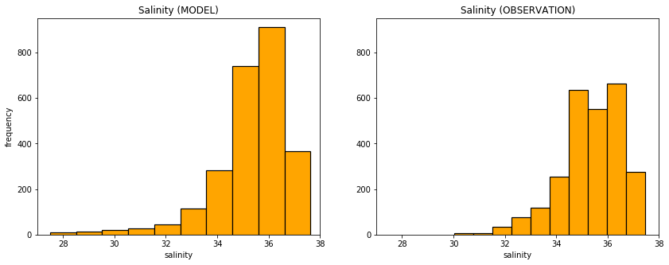
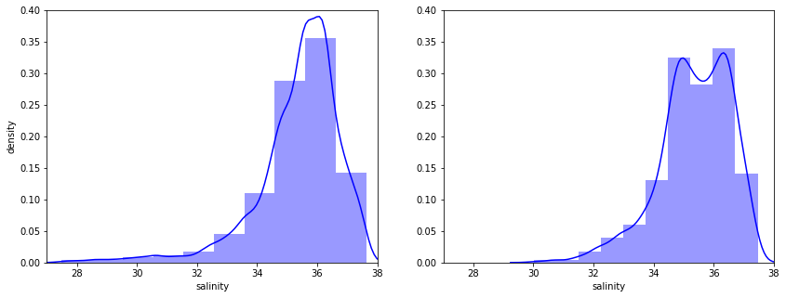
Mod v. Obs: Salinity (SAL)
Sunday, 11/12/2017
Notes:
source:
http://www.uky.edu/KGS/pubs/ic60_11whatsit.htm

Slide 9
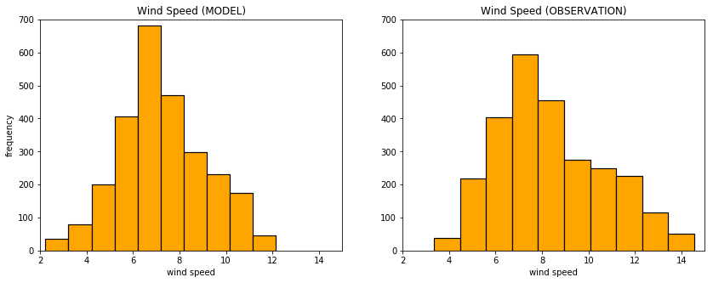
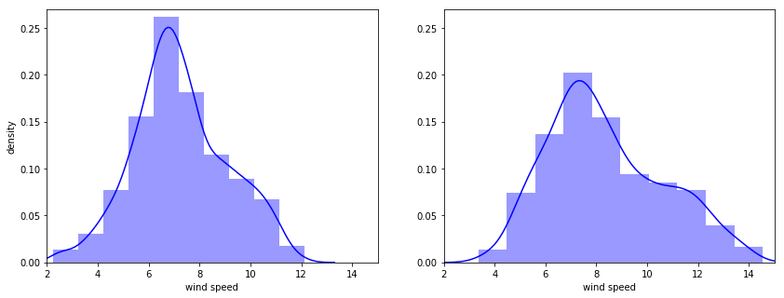
Mod v. Obs: Wind Speed (WSPD)
Sunday, 11/12/2017

